Slide 1

Understanding the LPAs’ Roles and Responsibilities
Mike Penick, SR/WA
Acquisitions Manager, Public Works Department
Louisville/Jefferson County Metro Government

Slide 2
Topics
The LPA, “Lingo”, and FHWA Orders
The LPA Project Guide
Funding Flowchart
Running an LPA Project
The Uniform Act and Real Estate Services
Summary and Recap

Slide 3


What is an LPA?
FHWA Definition
Local public agency means any city, county, township, municipality, or other political subdivision that may be empowered to cooperate with the STA in roadway matters.
[23 CFR 635.102]

Slide 4

Understanding the “Lingo”
STA: State Transportation Agencies
S&O: Stewardship and Oversight Agreement
RBSO: Risk-Based Stewardship and Oversight
USC: United States Codes
CFR: Code of Federal Regs
PCA: Plan of Corrective Action
CAP: Compliance Assessment Program
FAP: Federal-Aid Projects

Slide 5
FHWA Order 5020.2
Defines the STAs’ roles and responsibilities for S&O of LPA-administered FAPs
Establishes a uniform method for assessing risk in the STAs’ S&O of LPA-administered FAPs
Establishes a uniform method for ensuring federal compliance of LPA-administered FAPs
https://www.fhwa.dot.gov/legsregs/directives/orders/50202.cfm (August 14, 2014)

Slide 6
The LPA Project Guide
http://transportation.ky.gov/Local-Programs/LPA/Pages/default.aspx

Slide 7
The Funding Flowchart
CONGRESS
FHWA
COMMONWEALTH
KYTC
CITY
COUNTY
MUNICIPALITY
LPA

Slide 8
Running an LPA Project
Coordinate meetings with KYTC and consultants, including joint inspections and utilities
Using KYTC/Central Office approved staff and/or consultants on projects (Appraisers, Title Examiners, Negotiators, and Relocation Agents)
Approved project forms, documents, and files
Project manage and consultant monitoring
Status reports and project updates
Property Management and Demolition
Right-of-Way Project Certification (TC62-226)

Slide 9

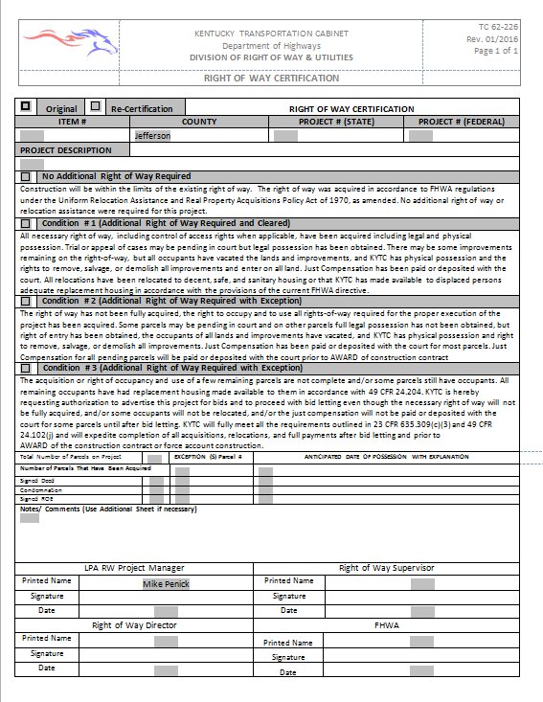

Slide 10

Uniform Act and Real Estate Services
The introduction of Moving Ahead for Progress in the 21st Century Act (MAP-21) meant changes to the provisions in the Uniform Act (49 CFR Part 24) and changes to real property acquisitions and property management (23 CFR Part 710).
It is imperative that anyone not familiar with these changes speak to the ROW Division at KYTC or Central Office.

Slide 11
Recap
LPAs must follow all guidelines established by FHWA
If ONE DOLLAR of any project funding source is from FHWA, all of their policies apply, regardless of the additional funding
LPAs recognize that the STA is the steward and enforcer of the guidelines laid out by FHWA
Obtain and use all approved document forms
Require project status reports and meetings; be informed
Ask questions! Make no assumptions or major project decisions without STA involvement
Only through coordination and collaboration can a project be successful

Slide 12


Questions or Comments?
Mike Penick, SR/WA
Louisville/Jefferson County Metro Gov’t
mike.penick@louisvilleky.gov
502-574-5338

